Slide 1
# pay-as-you-go licensing
# Azure Hybrid Benefits activation
# Azure Virtual Desktop on Azure Stack HCI
# Hosted environments
Sven Langenfeld
Azure Stack HCI Commercial Sales Specialist
Azure Stack HCI Licensing Deck

Slide 2
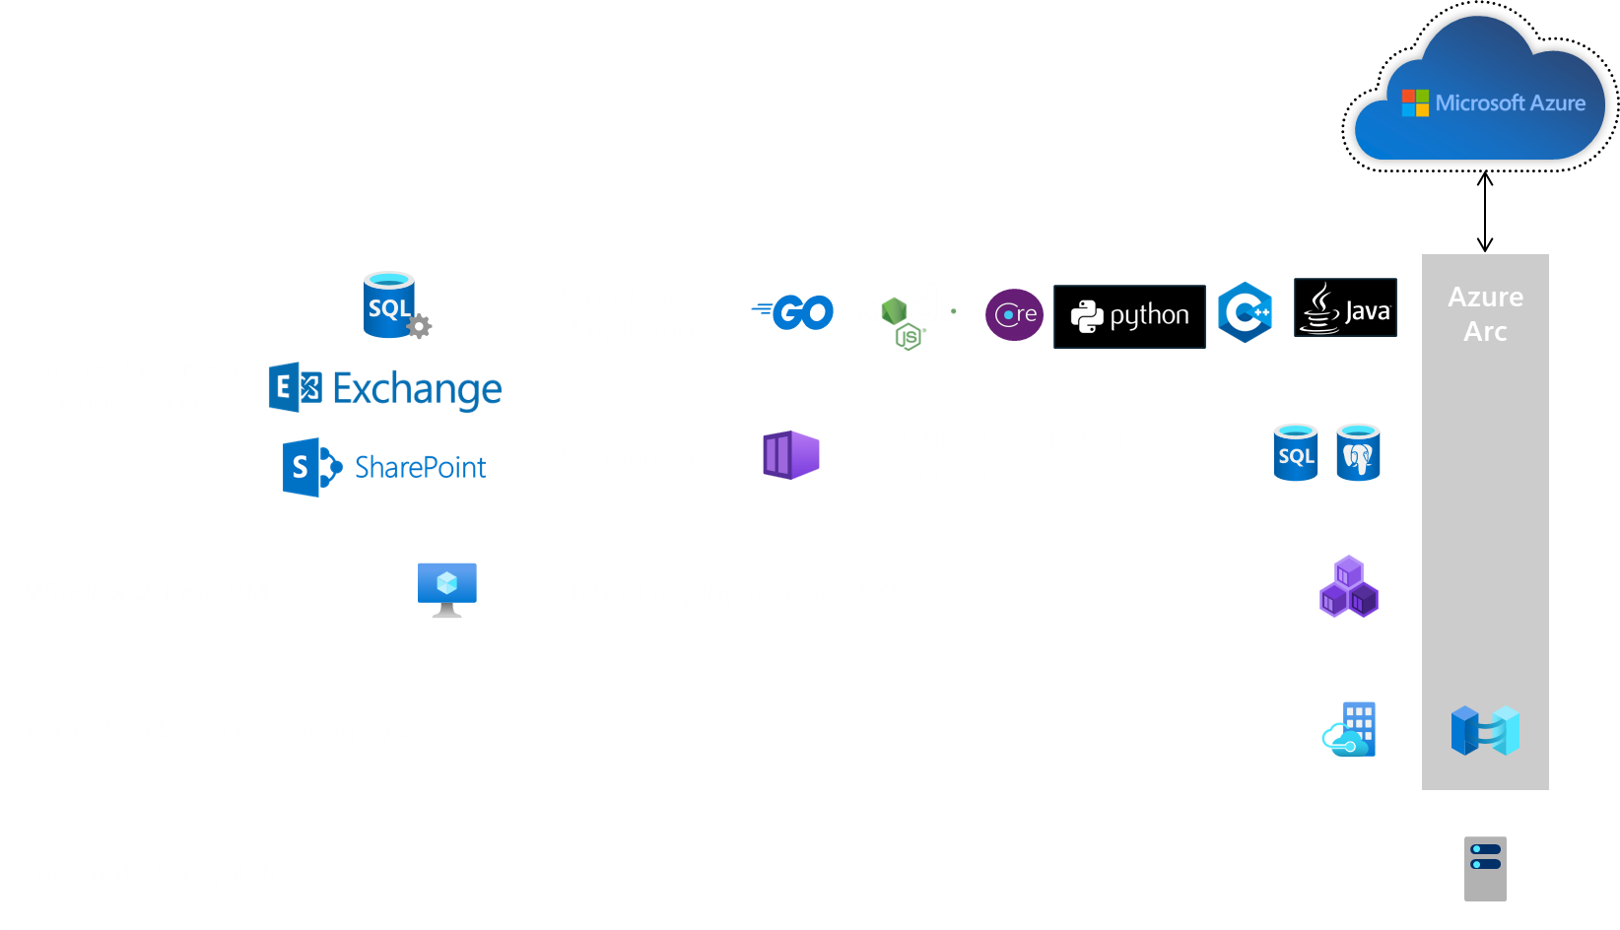
platform architecture

Slide 3
USD $10/month
per ACTIVE physical processor core
guest OS not included
60 days trial for free
no hidden cost
pay-as-you-go licensing

Slide 4
Azure Hybrid Benefits activation

Slide 5
Azure Hybrid Benefits activation

Slide 6
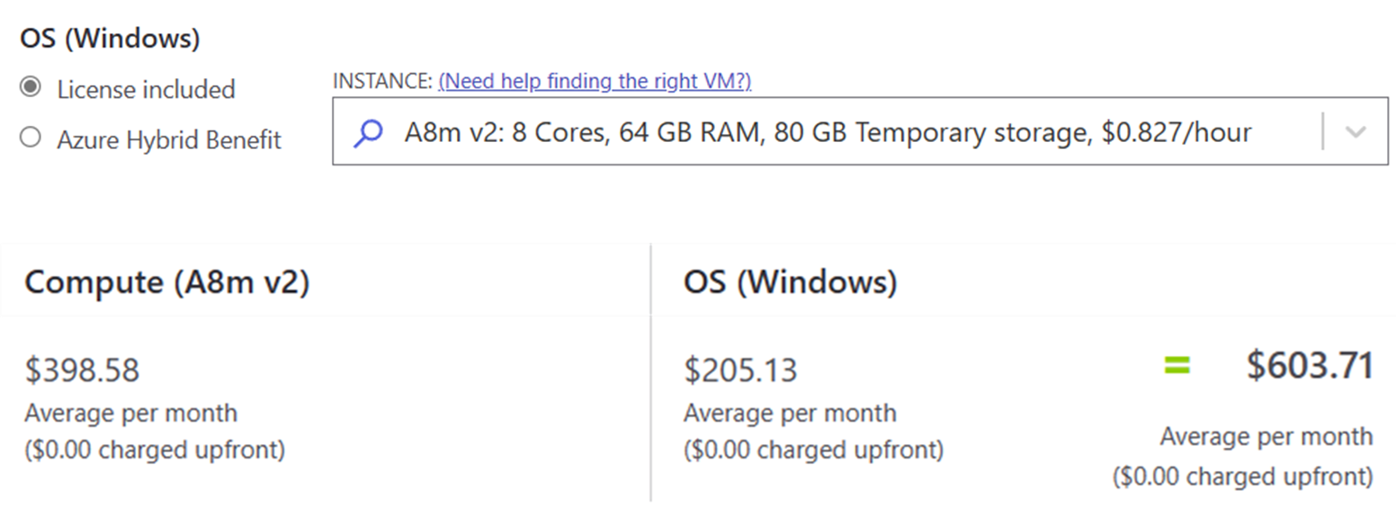
Azure Hybrid Benefits activation

Slide 7
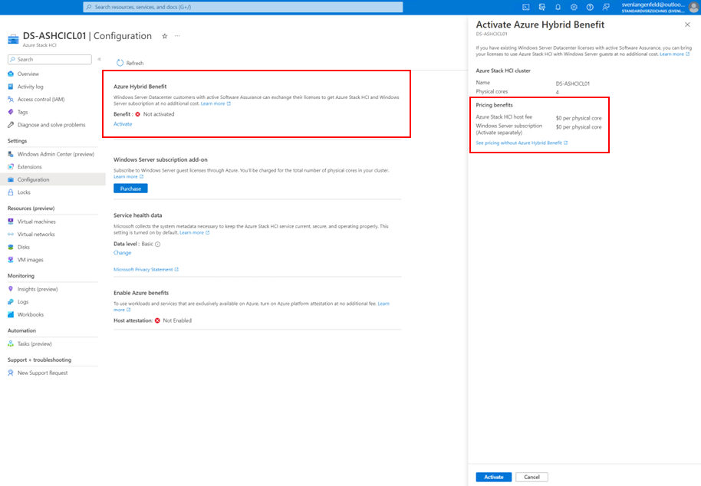
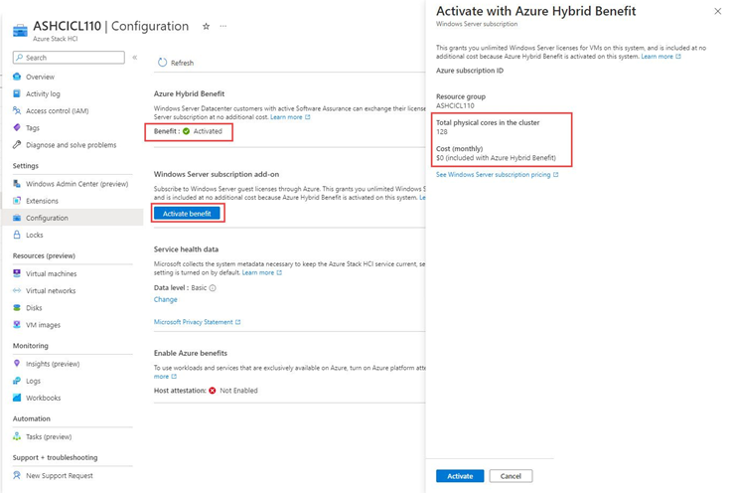
AND!
Azure Hybrid Benefits activation

Slide 8
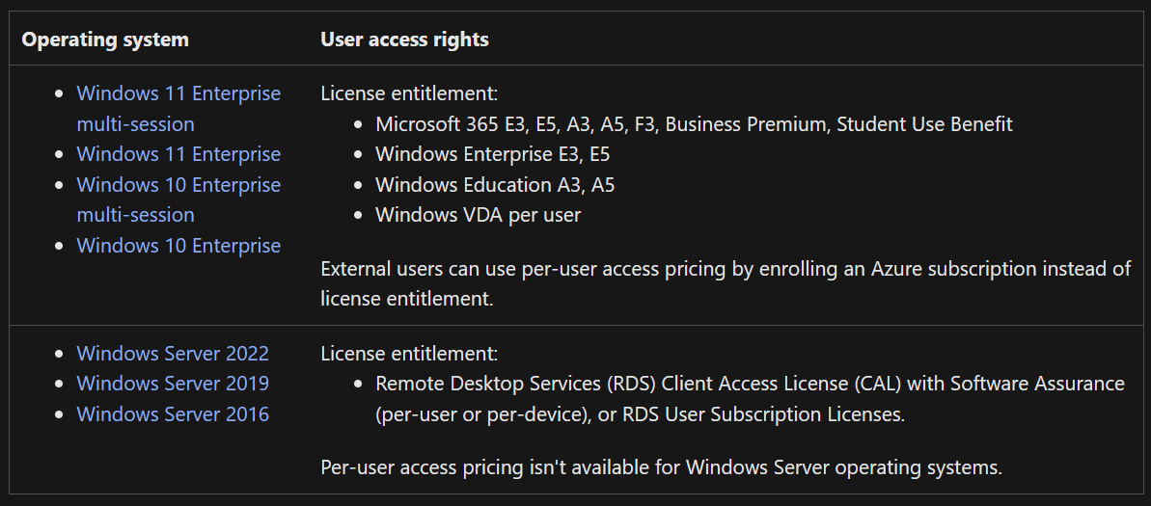
+ 0.01$ per vCore per hour
Azure Virtual Desktop on Azure Stack HCI

Slide 9
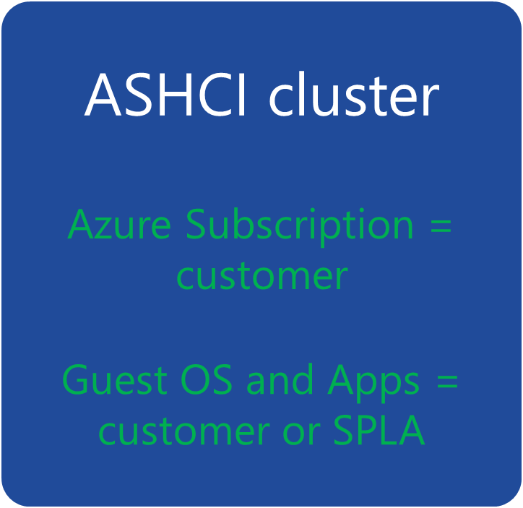
Customer
Hoster
ASHCI cluster
ASHCI cluster
Azure Subscription = customer
VMs or any other “Azure” services
Azure Subscription = Hoster
Guest OS and Apps = customer or SPLA
unique ISV services
Azure Subscription = Hoster
Hosted environments

Slide 10
Thank you and good bye!

